Slide 1
AN introduction to python

Slide 2
Why me
Currently studying MSc Health Data Science and Statistics and got a 1st class honours in Mathematics and Statistics.
Coded in Python and R for 3 years

Slide 3
Installing on your own device
The Anaconda distribution
Package and environment manager (more about this later)
Comes with good packages and IDE’s pre-installed
Go to www.anaconda.com/download and click Install (should automatically have the right system displayed).

Slide 4
What is a virtual environment?
Lightweight, self-contained python installations
We use them to avoid system pollution, dependency conflicts and reproducibility issues.
It won’t seem to be particularly useful at first but it is a good practice to get into.

Slide 5
How to set up your own virtual environment
Open your Terminal/Command Prompt/Powershell/Anaconda Prompt
Type “conda create –n yourenvname python anaconda”
Follow the prompts on screen
Now you have your own virtual environment to work within

Slide 6
What is a package?
A package is a container that contains various functions to perform specific tasks.
They exist so we don’t waste our time writing code that has already been written.
Some already exist in your base version of Python, such as the ‘Math’ package, which contains the sqrt() function.
Some we have to install, such as the Matplotlib package.

Slide 7
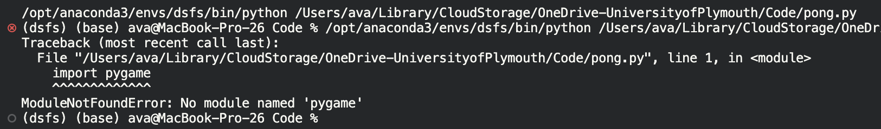
What do I do when I want to work with a new package?
If you try to import a package you may encounter a ‘ModuleNotFoundError’.
This is because you have to install it in your environment in the terminal using ‘conda install modulename’.
You can do this either directly in the notebook you are working in or in the Terminal/Command Prompt/PowerShell. Make sure your desired environment is activated!

Slide 8

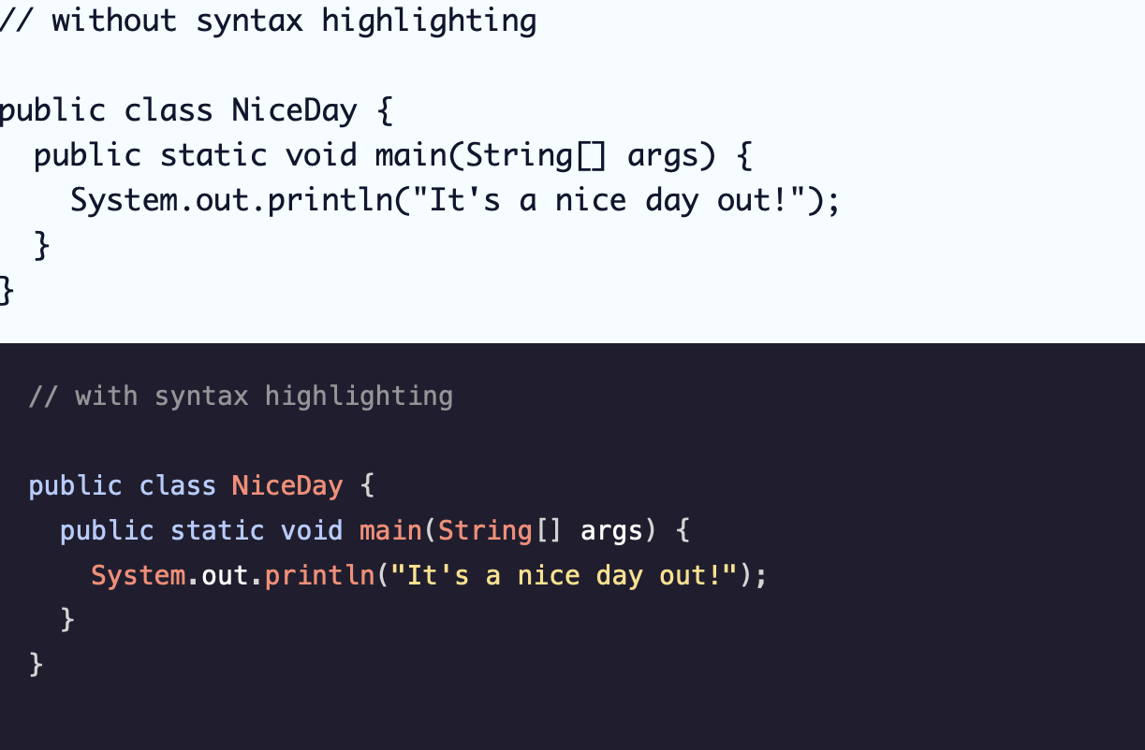
What is an ide?
IDE – Integrated Development Environment.
Very helpful – syntax highlighting, auto-completion, debugging tools and more.

Slide 9

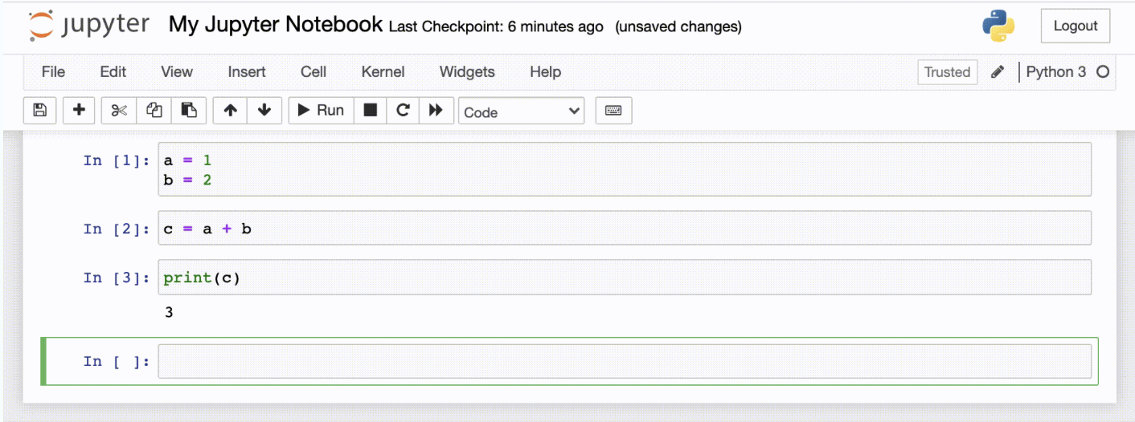
Which ide is right for me?
There are a lot out there, but this is largely up to you and will take some trial and error to find what works well for you.
Anaconda comes with some IDE’s, most notably Spyder and Jupyter Notebook
Anaconda also works with other IDE’s available, such as VSCode and PyCharm.
Today we will be using Jupyter Notebooks

Slide 10
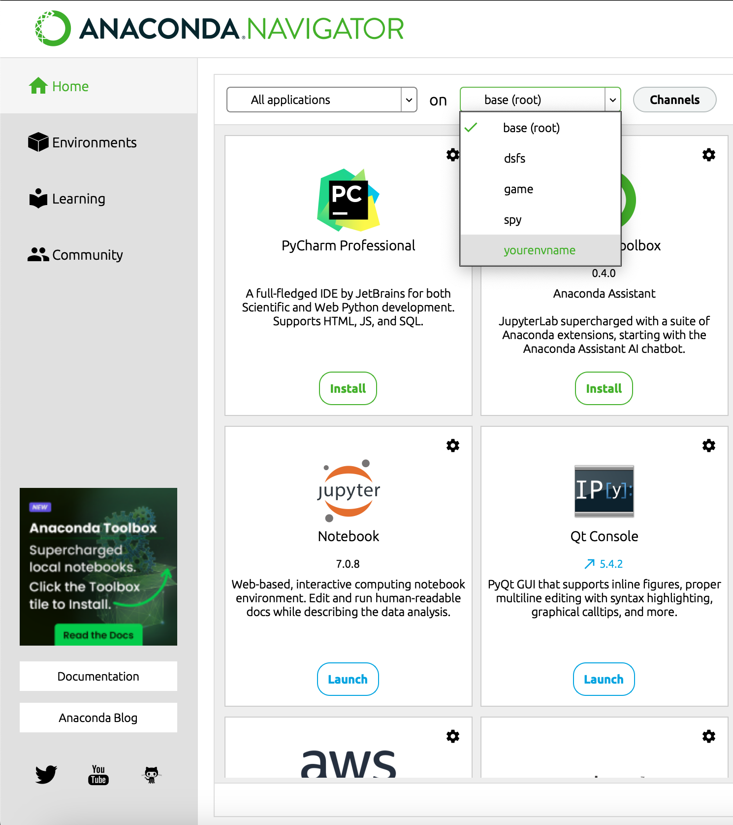
How to open a new jupyter notebook method 1 – using anaconda navigator
Open the Anaconda Navigator and make sure to select the environment you just created from the drop-down menu.

Slide 11
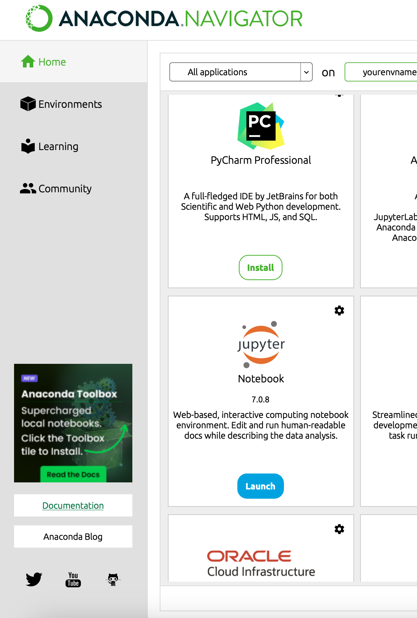
Click ‘Install’ on the Jupyter Notebook tile and then ‘Launch’ once the app has installed itself.

Slide 12
Method 2 – from the command line
Open your terminal/anaconda prompt/powershell and activate your environment with ‘conda activate yourenvname’
Install jupyter notebooks with conda install jupyter notebook and follow the onscreen prompts
When installation is finished type ‘jupyter notebook’ to open the app in your activated environment

Slide 13
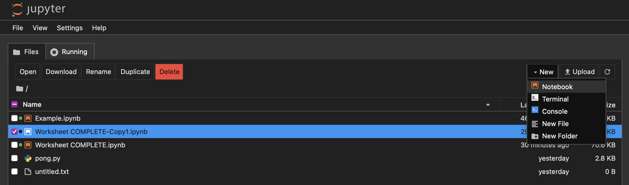
Creating a new notebook file
Navigate to your chosen directory and click New > Notebook
You will then see a file called “Untitled.ipynb” appear
Name accordingly and double click to open

Slide 14
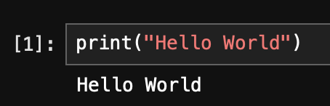
First hello world
Now you have your first notebook file!
Let’s try something out… type ”print(’hello world’)” and then press Shift+Enter
Now you have your first hello world in python ☺

Slide 15
worksheet
There is a worksheet available at: https://github.com/avakeeling199/intro-to-python that will take you through some basic Python commands.
Please ask if you have any questions ☺
Thank you!

